Slide 1
Chapter 9
Why Do Financial Crises Occur
(Why they occur and why they have such devastating effects on the economy.)
Notes:
If this PowerPoint presentation contains mathematical equations, you may need to check that your computer has the following installed:
1) MathType Plugin
2) Math Player (free versions available)
3) NVDA Reader (free versions available)

Slide 2
Learning Objectives
Define the term “financial crisis.”
Identify the key features of the three stages of a financial crisis.
Describe the causes and consequences of the global financial crisis of 2007–2009.
Summarize the changes to financial regulation that developed in response to the global financial crisis of 2007–2009.
Identify the gaps in current financial regulation and how they might be addressed with future regulatory changes.

Slide 3
Global: The European Sovereign Debt Crisis
The increase in budget deficits that followed the financial crash of 2007–2009 led to fears of government defaults and a surge in interest rates.
The sovereign debt crisis, which began in Greece, moved on to Ireland, Portugal, Spain, and Italy.
The stresses created by this and related events continue to threaten the viability of the euro.

Slide 4
What Is a Financial Crisis?
A financial crisis occurs when there is a particularly large disruption to information flows in financial markets, with the result that financial frictions increase sharply and financial markets stop functioning.

Slide 5
Dynamics of Financial Crises
Stage One: Initiation of a Financial Crisis
Credit Boom and Bust: Mismanagement of financial liberalization/innovation drives down the net worth of banks and triggers the deleveraging process
Asset-price Boom and Bust
As the asset-price bubble burst, the net worth of companies declines, encouraging firms to make riskier investment
Increase in Uncertainty

Slide 6
Dynamics of Financial Crises
Stage two: Banking Crisis
Deteriorating balance sheets may lead financial institutions into insolvency
Savers withdraw their deposits and banks sell off assets to raise necessary funds
The fire sales cause asset prices to drop again and more banks to fail
Stage three: Debt Deflation
As debt payments are fixed in nominal terms, an unanticipated decline in price level will raise the burden of the debt in real terms

Slide 7
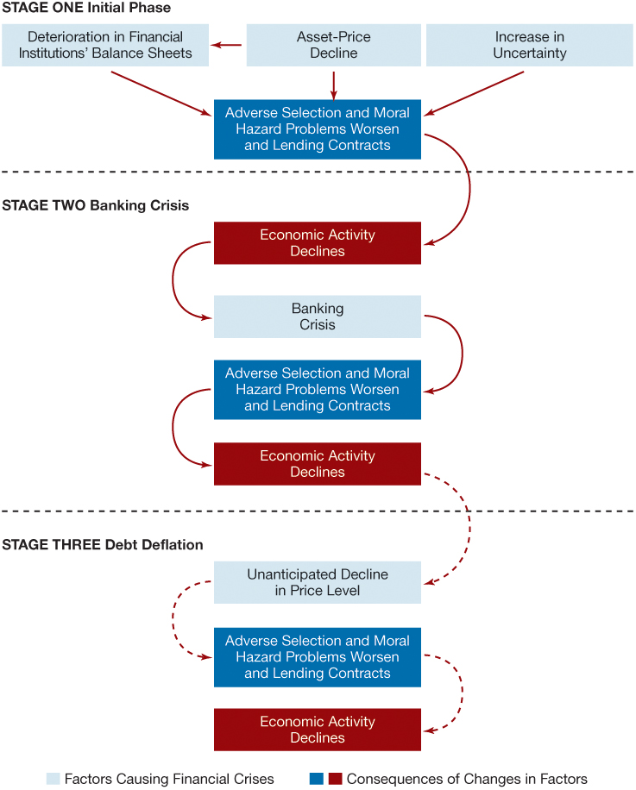
Figure 1 Sequence of Events in Financial Crises in Advanced Economies

Slide 8
The Mother of All Financial Crises: The Great Depression
How did a financial crisis unfold during the Great Depression and how it led to the worst economic downturn in the history of the United States and other advanced economies?
This event was brought on by:
Stock market crash
Bank panics
Continuing decline in stock prices
Debt deflation

Slide 9
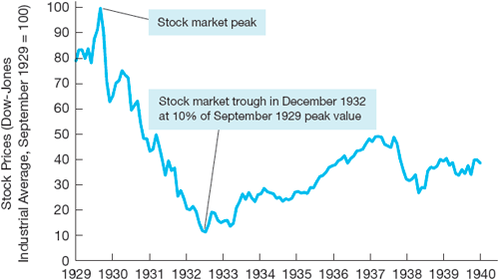
Figure 2 Stock Price Data During the Great Depression Period
Source: Dow-Jones Industrial Average (DJIA). Global Financial Data: http://www.globalfinancialdata.com/index_tabs.php?action=detailedinfo&id=1165 .

Slide 10
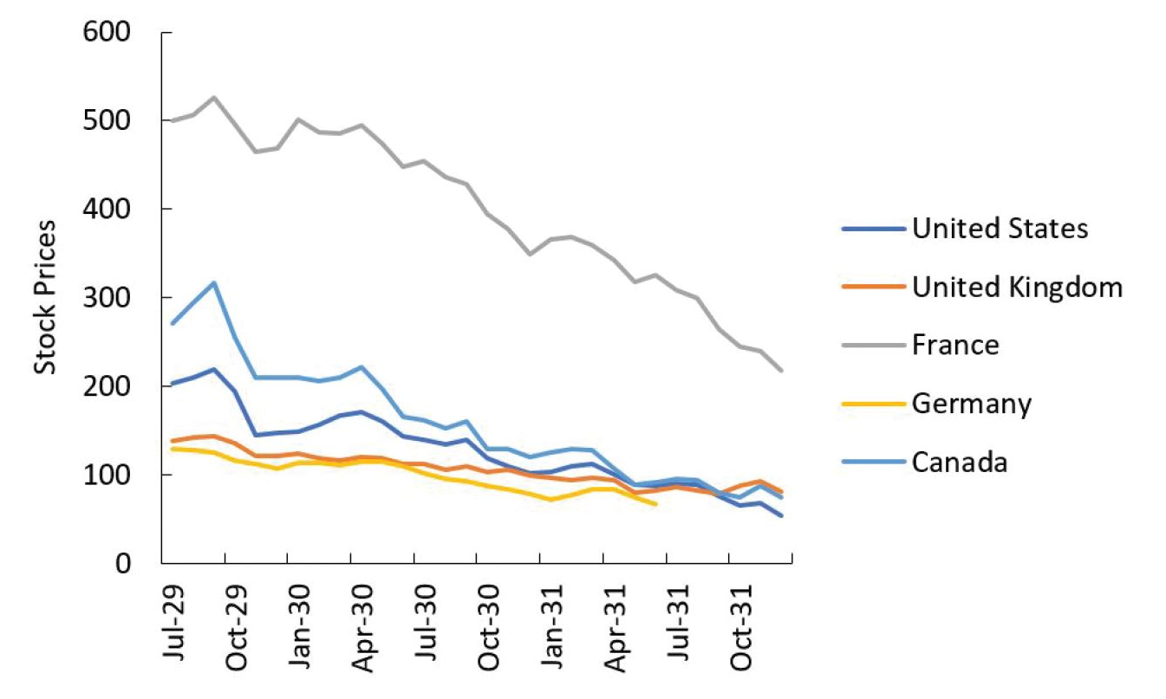
Figure 3 Stock Price Indexes in a Selected Number of Advanced Economies, 1929–1931
Source: Adapted from Kindleberger, 1986, Figure 6..

Slide 11
The Global Financial Crisis of 2007–2009 (1 of 8)
Causes of the 2007–2009 Financial Crisis:
Financial innovations emerge in the mortgage markets
Subprime mortgage
Mortgage-backed securities
Collateralized debt obligations (CDOs)
Housing price bubble forms
Increase in liquidity from cash flows surging to the United States
Development of subprime mortgage market fueled housing demand and housing prices

Slide 12
The Global Financial Crisis of 2007–2009 (2 of 8)
Causes (cont’d):
Agency problems arise
“Originate-to-distribute” model is subject to principal-(investor) agent (mortgage broker) problem
Borrowers had little incentive to disclose information about their ability to pay
Commercial and investment banks (as well as rating agencies) had weak incentives to assess the quality of securities
Information problems surface
Housing price bubble bursts

Slide 13
The Global Financial Crisis of 2007–2009 (3 of 8)
Effects of the 2007–2009 Financial Crisis
The growth in subprime mortgage market increased demand for houses and so fueled the boom in housing prices
After a sustained boom, housing prices in the U.S. and other countries (such as Ireland or Spain) began a long decline, starting in 2006.
The decline in housing prices contributed to a rise in defaults on mortgages and a deterioration in the balance sheet of financial institutions.
This development in turn caused a run on the shadow banking system.

Slide 14
The Global Financial Crisis of 2007–2009 (4 of 8)
Origins: U.S. financial markets
Crisis spreads globally
Sign of the globalization of financial markets
TED spread (3 months interest rate on Eurodollar minus 3 months Treasury bills interest rate) increased from 40 basis points to almost 240 in August 2007.

Slide 15
The Global Financial Crisis of 2007–2009 (5 of 8)
Deterioration of financial institutions’ balance sheets:
Write downs
Sell of assets and credit restriction
High-profile financial firms fail, in the U.S. and Europe
In the United States: Bear Stearns (March 2008), Fannie Mae and Freddie Mac (July 2008), Lehman Brothers, Merrill Lynch, AIG, Reserve Primary Fund (mutual fund) and Washington Mutual (September 2008)

Slide 16
The Global Financial Crisis of 2007–2009 (6 of 8)
High-profile financial firms fail, in the U.S. and Europe (contd.)
In the United Kingdom: Northern Rock (September 2008), Royal Bank of Scotland (October 2008)
Elsewhere: BPN (Portugal, November 2008), Anglo-Irish Bank (January 2009), the whole Icelandic banking sector (October 2008)

Slide 17
The Global Financial Crisis of 2007–2009 (7 of 8)
Bailouts
In the United States, Congress approved a $787 billion economic stimulus plan on February 13, 2009.
In the United Kingdom, the government announced a £500 billion bank rescue package in October, 2008.
Similarly, in countries such as Ireland, Spain, Belgium, and the Netherland, large scale rescue plans were announced to bail out ailing banks.

Slide 18
The Global Financial Crisis of 2007–2009 (8 of 8)
Height of the 2007–2009 Financial Crisis
The stock market crash gathered pace in the fall of 2008, with the week beginning October 6, 2008, showing the worst weekly decline in U.S. history.
Surging interest rates faced by borrowers led to sharp declines in consumer spending and investment.
The unemployment rate shot up, going over the 10% level in late 2009 in the midst of the “Great Recession, the worst economic contraction in the United States since World War II.
Political consequences: electoral defeat of incumbent governments (Iceland, UK), unrest, increased polarization

Slide 19
Government Intervention and the Recovery
Short-term Responses and Recovery
Financial Bailouts: In order to save their financial sectors and to avoid contagion, financial support was provided by many governments to bail out banks, other financial institutions, and even the so-called “too-big-to-fail” firms that were severely affected by the financial crisis.
Fiscal Stimulus Spending: To boost their individual economies, most governments used fiscal stimulus packages that combined government expenditure and tax cuts.

Slide 20
Stabilizing the Global Financial System: Long-Term Responses
With the individual emergency national bailouts to rescue national economies and financial sectors, global leaders looked to building a more stable and robust global financial system. Steps taken by governments included
Implement sound macroeconomic policies
Enhance their financial infrastructure
Develop financial education and consumer protection rules
Enact macro- and microprudential regulations.

Slide 21
Long-Term Responses (contd.)
At the international level
proactive globally-binding supervision was designed
financial market discipline enforced
systemic risk managed
To avoid collective action problems and to ensure that policy actions are mutually consistent with national growth objectives, aggregate plans began to be drafted simultaneously. The first ever of these is the Mutual Assessment Process (MAP) launched in 2009 by the G20.

Slide 22
Dynamics of Financial Crisis in Emerging Market Economies (1 of 5)
Stage one: Initial Phase
Path A: Credit Boom and Bust
Weak supervision and lack of expertise lead to a lending boom.
Domestic banks borrow from foreign banks.
Fixed exchange rates give a sense of lower risk.
Banks play a more important role in emerging market economies, since securities markets are not well developed yet.
At this stage emerging economies may report “sound fundamentals.” For example, fiscal positions may be sound.
Credit boom is associated with deteriorating balance of payments.

Slide 23
Dynamics of Financial Crisis in Emerging Market Economies (2 of 5)
Stage one: Initial Phase
Path B: Severe Fiscal Imbalances
Governments in need of funds sometimes force banks to buy government debt.
When government debt loses value, banks lose and their net worth decreases.
Additional factors:
Increase in interest rates (from abroad)
Asset price
Decrease firms' net worth and thus increase adverse selection problems
Uncertainty linked to unstable political systems

Slide 24
Dynamics of Financial Crisis in Emerging Market Economies (3 of 5)
Stage two: Currency Crisis
Deterioration of bank balance sheets triggers currency crises:
Government cannot raise interest rates (doing so forces banks into insolvency)…
… and speculators expect a devaluation.
Note difference with advanced economies (where bank failures do not cause currency crisis)
Severe fiscal imbalances triggers currency crises:
Foreign and domestic investors sell the domestic currency.

Slide 25
Dynamics of Financial Crisis in Emerging Market Economies (4 of 5)
Stage three: Full-Fledged Financial Crisis
Currency mismatch: another difference from advanced economies
Arises out of the denomination of many debt contracts in a foreign currency (usually a foreign reserve currency such as the US$)
At the same time, however, domestic income denominated in local currency
With currency crisis, firms face a higher debt
Net worth decreases and averse selection problems increases

Slide 26
Dynamics of Financial Crisis in Emerging Market Economies (5 of 5)
Stage three: Full-Fledged Financial Crisis
Debt burden in terms of domestic currency increases (net worth decreases).
Increase in expected and actual inflation reduces firms’ cash flow.
“Twin crisis”
Banks are more likely to fail:
Individuals are less likely to payoff debts (value of assets fall)
Debt denominated in foreign currency increases (value of liabilities increase)

Slide 27
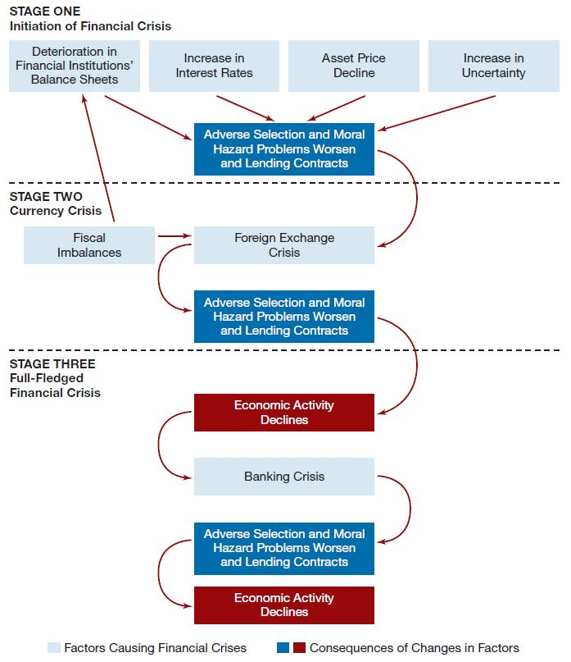
Figure 1 Sequence of Events in Emerging Market Financial Crises

Slide 28
Preventing Emerging Market Financial Crises
Beef up prudential regulation and supervision of banks
Encourage disclosure and market-based discipline
Limit currency mismatch
Sequence financial liberalization

